Slide 1
Education Portal
DeLC 2.0
15th workshop on “Software engineering education and reverse engineering”
Bohinj, Slovenia
Emil Doychev, Veselina Valkanova, Vladimir Valkanov, Asya Stoyanova-Doycheva
University of Plovdiv, Bulgaria
24.08.2015

Slide 2
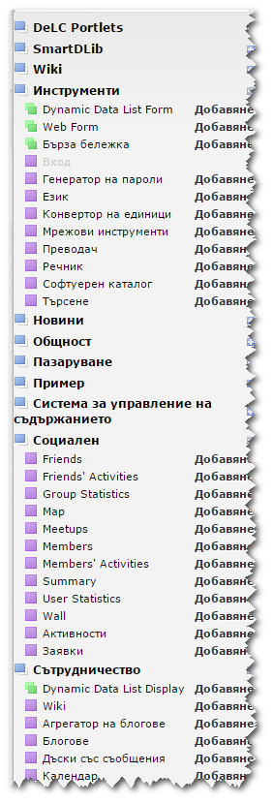

Short History
DeLC as a name (Distributed eLearning Center) exists for more than 10 years in the University of Plovdiv.
A portal, which delivers e-learning services, in use since 2010.
The first version was built over Liferay (www.liferay.com) framework.
  The best open source portal, written entirely in Java
  Many ready for use portlets:
    Documents & Media – static resources repository;
    Web Content – CMS for static content;
    Message Board – Forum;
    Page Comments;
    News и Alerts;
    Dynamic Data List;
    Chat
    and many more…

Slide 3
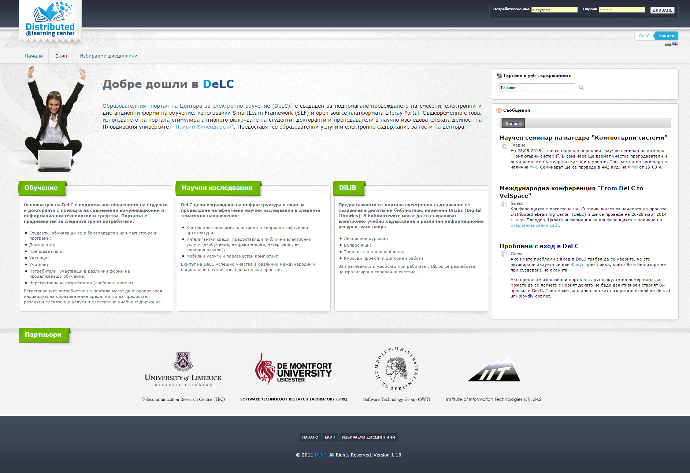
Short History

Slide 4
Short History
Current state (Liferay version):
  Integrated with external authorization system (LDAP: https://focus.uni-plovdiv.net), for the students accounts.
  More than 2100 active accounts of students
  Support for 13 disciplines in the bachelors and 7 in the masters programs at FMI
  Library with more than 400 static resources
  Own assessment system. Some stats (actual to 11.06.2015):
    Contains 184 electronic tests;
    Executed 10 840 times.
  Subsystem for choosing optional disciplines.
  Subsystem for registration of students projects and student teams.
  Subsystem for registration for consultations with project mentors.
  Integrated with external system for project management (Redmine).

Slide 5
Major Problems
Liferay Enterprise Edition price is relatively high. Thus we use the Community Edition
  The same functionality as the Enterprise edition
  Lack of support
  Very hard to upgrade
Urgent need to upgrade to the last version (current 6.1 GA2, actual 6.2 GA4, missed 5 upgrades)
Recreate the web design with support for mobile devices
Significant changes in the assessment system (implement QTI support)
Urgent need to integrate with our own SCORM Player
Need to develop new modules
Very slow development for Liferay
Lack of resources

Slide 6
Why not existing system?
There are many existing e-learning systems
  Moodle
  CourseSites (by Blackboard)
  Sakai (Community Edition)
  …
DeLC goal is not only to provide standard e-learning services.
  A tool for science research in blended and lifelong learning areas.
  Provide services based on standards - SCORM 2004 R4, QTI 2, (Common Cartridge) …
  Implementation of services accessible anytime and anywhere (also on mobile devices), by using of intelligent software agents.
  More by Vladimir Valkanov in Wednesday.

Slide 7
Next Step – DeLC 2.0
Eliminating aggravating factors:
  Liferay – great platform, but it requires too much resources for support and development of custom functionality
Change the approach for the development of DeLC
  Framework – Grails
    Full stack framework
    Groovy language - Java world
    Agile development
  Focus only on the meaningful modules:
    SCORM 2004 R4
    Agent-oriented assessment system(QTI)
    Static resources
    Intelligent services

Slide 8
DeLC 2.0 Architecture
Application @ Browser
ExtJS
JQuery
Bootstrap
HTTP
REST
Web Socket
Application @ Server Side
SCORM Player
Plugin
Plugin
Plugins …
QTI Tests
Hibernate ORM
Message Queue
DB

Slide 9
What is the benefit?
Each subsystem is developed as separate project
  Independent development
  Flexible integration
  Easier upgrade
Application @ Server Side
SCORM Player
QTI Test System
Teacher Plan
Grade Book
…

Slide 10
DeLC 2.0 Plugins
Grails Plugins
  Spring Security
    Login/logout mechanism
    Control user access rules
Custom Plugins
  SCORM Player (in production)
  QTI Tests (in development, close to beta test)
  Library (in production)
  Grade Book (in development, Common Cartridge)

Slide 11
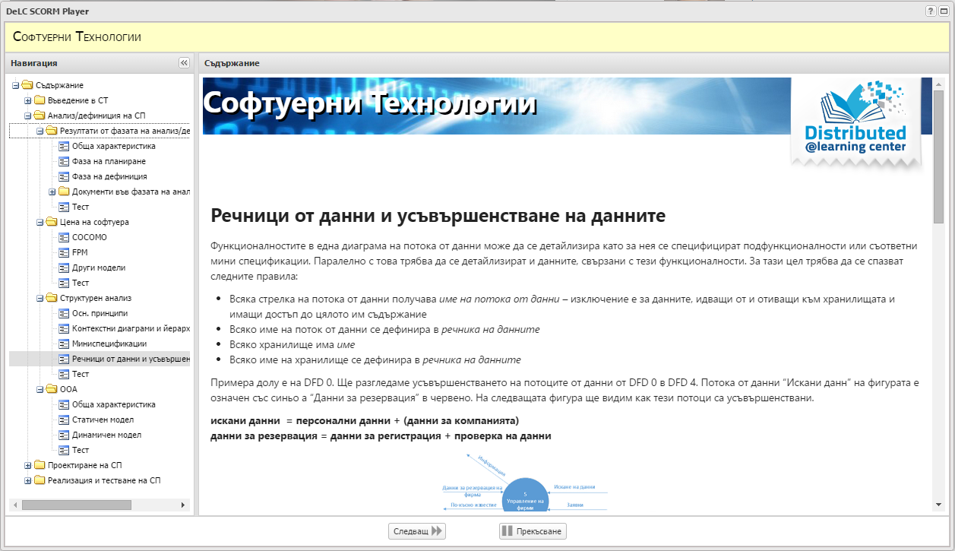
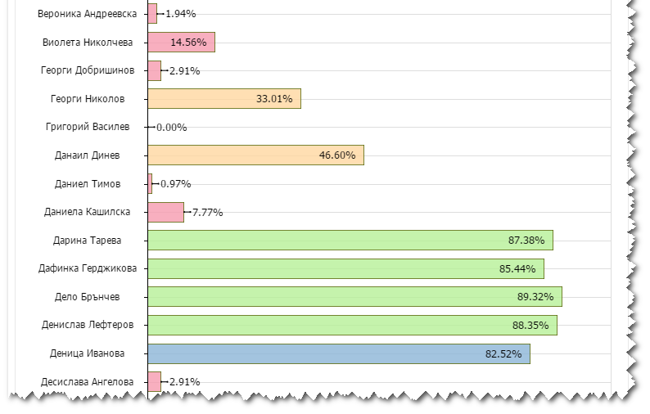
DeLC 2.0 SCORM Player Plugin

Slide 12
DeLC 2.0 QTI Tests Plugin

Slide 13
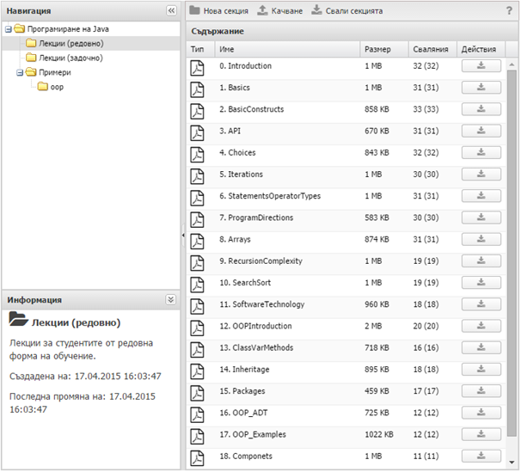
DeLC 2.0 Library Plugin

Slide 14
DeLC 2.0 QTI Support Architecture
DeLC
QTI Engine
Multiagent Environment
Browser Application
Server Logic
REST
Plugins Layer
REST
Storage Layer
REST
QTI Store
RESTFull Application

Slide 15
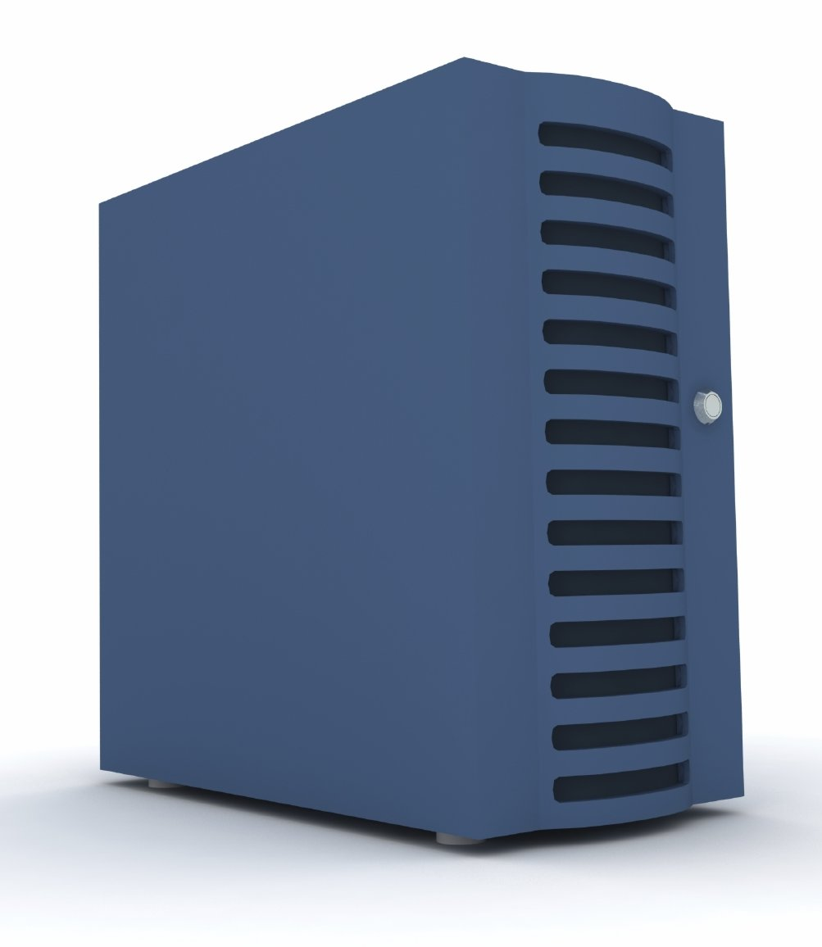
DeLC 2.0 Global Architecture
QTI Engine
University
Information System
DeLC 2
LDAP Server
Focus
User Management

Slide 16
DeLC 2.0 Content Structure
DeLC Home
OpenDeLC
Discrete Mathematics
Programming with Java
Theoretical Foundations of Informatics
OOP(with Java)
Informatics in Theory and Practice
Languages and Environments for Programming in the Internet
Science
Education
Database Integration in Web Environment
Artificial Intelligence
Practice (Java)
Projects
Artificial Intelligence
Software Technologies
Student projects
PhD Students
Semantic Web
Software Technologies
Computer Networks and Communications
Science Seminar
Intelligent Agents
Design Patterns
Database
Cognitive Robotics
Databases
Programming with Patterns and Frameworks
Digital Library
Programming for Oracle with PL/SQL
Actual problems of the Software Technologies

Slide 17
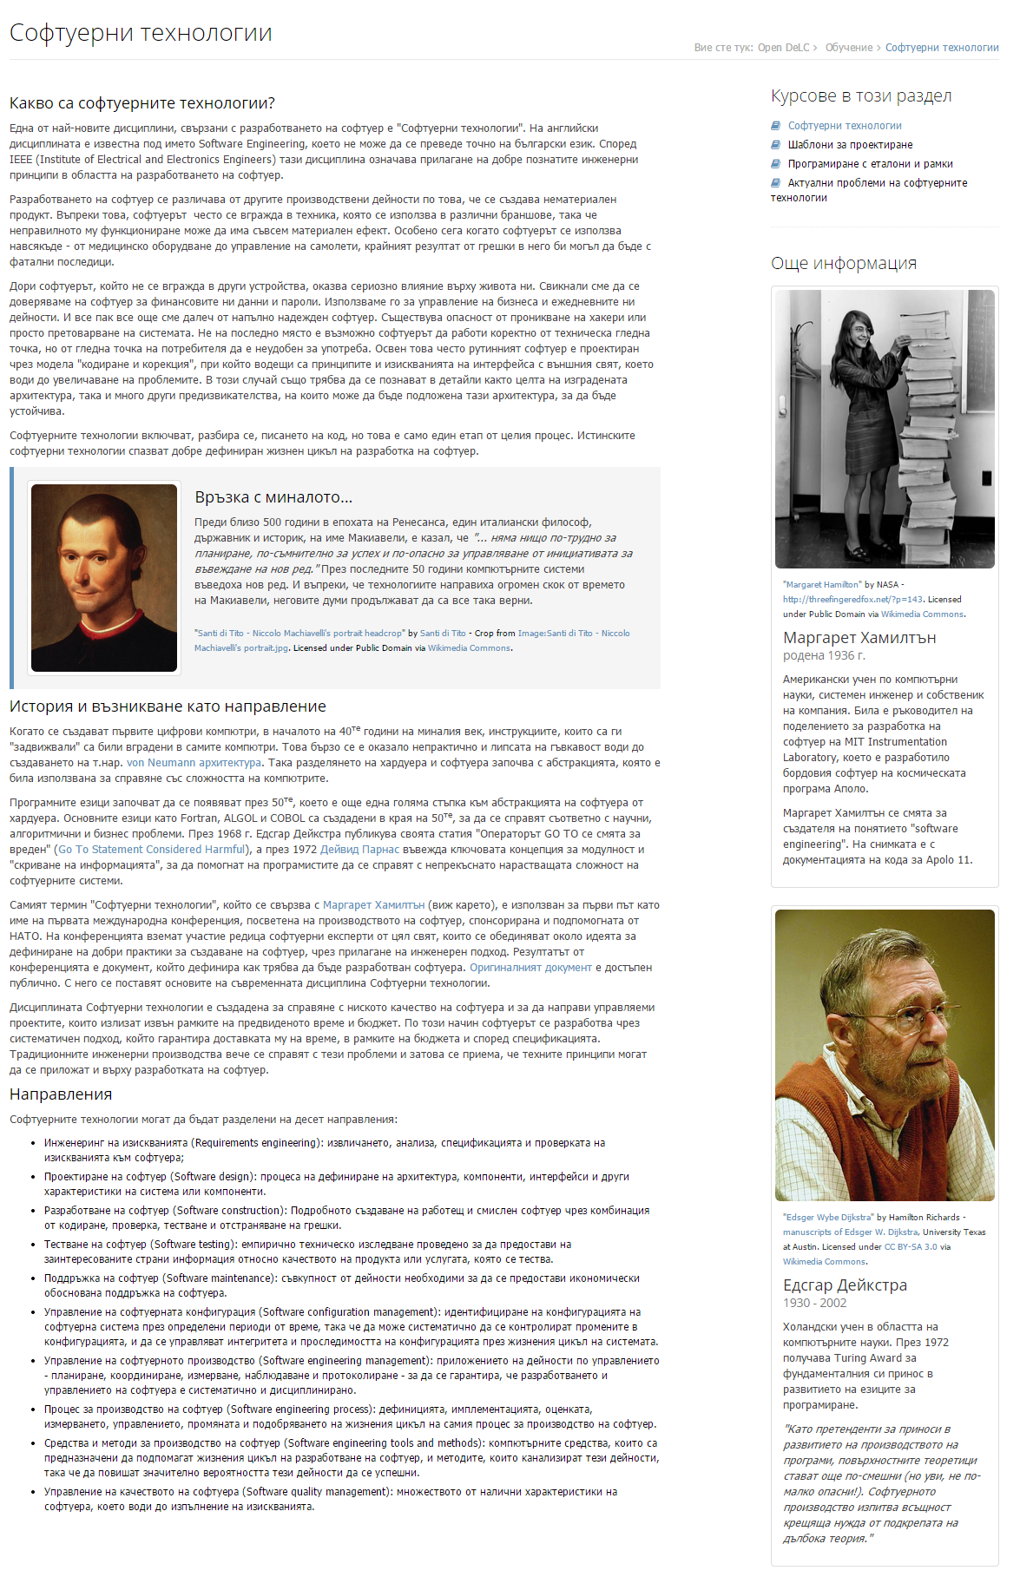
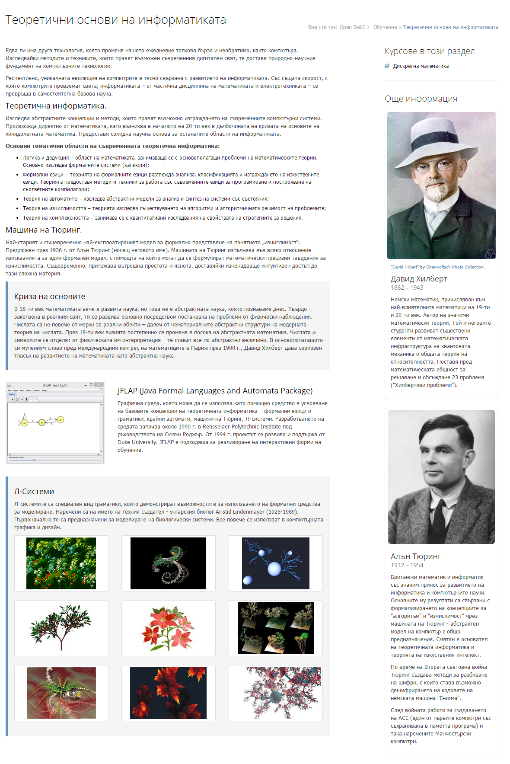
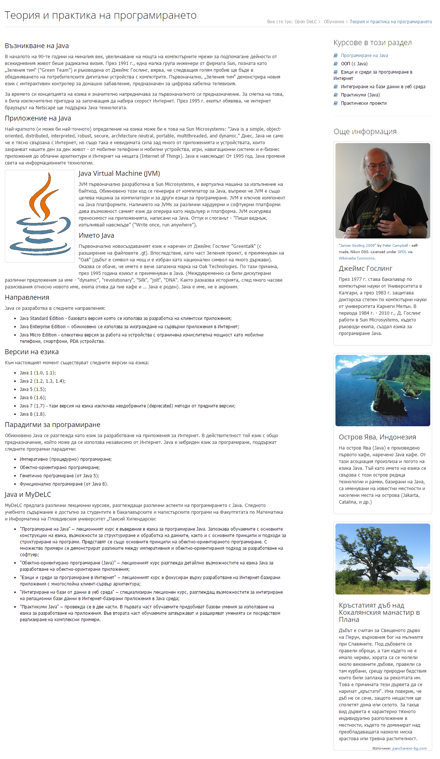
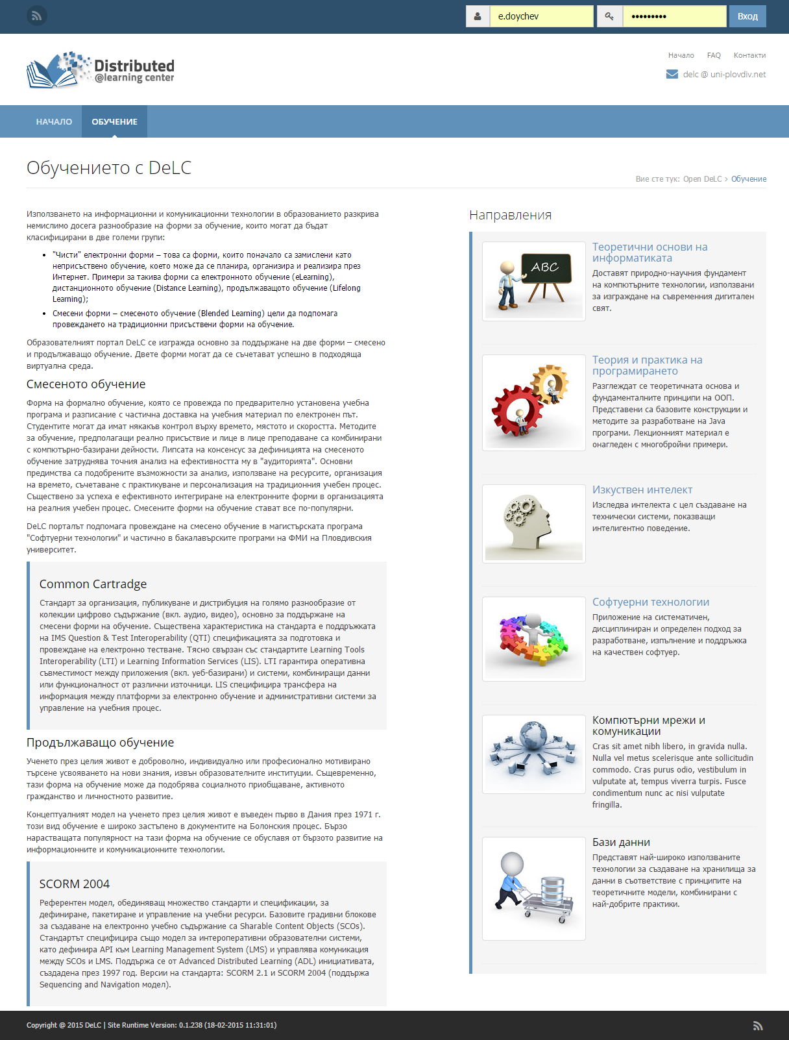
DeLC 2.0 Content

Slide 18
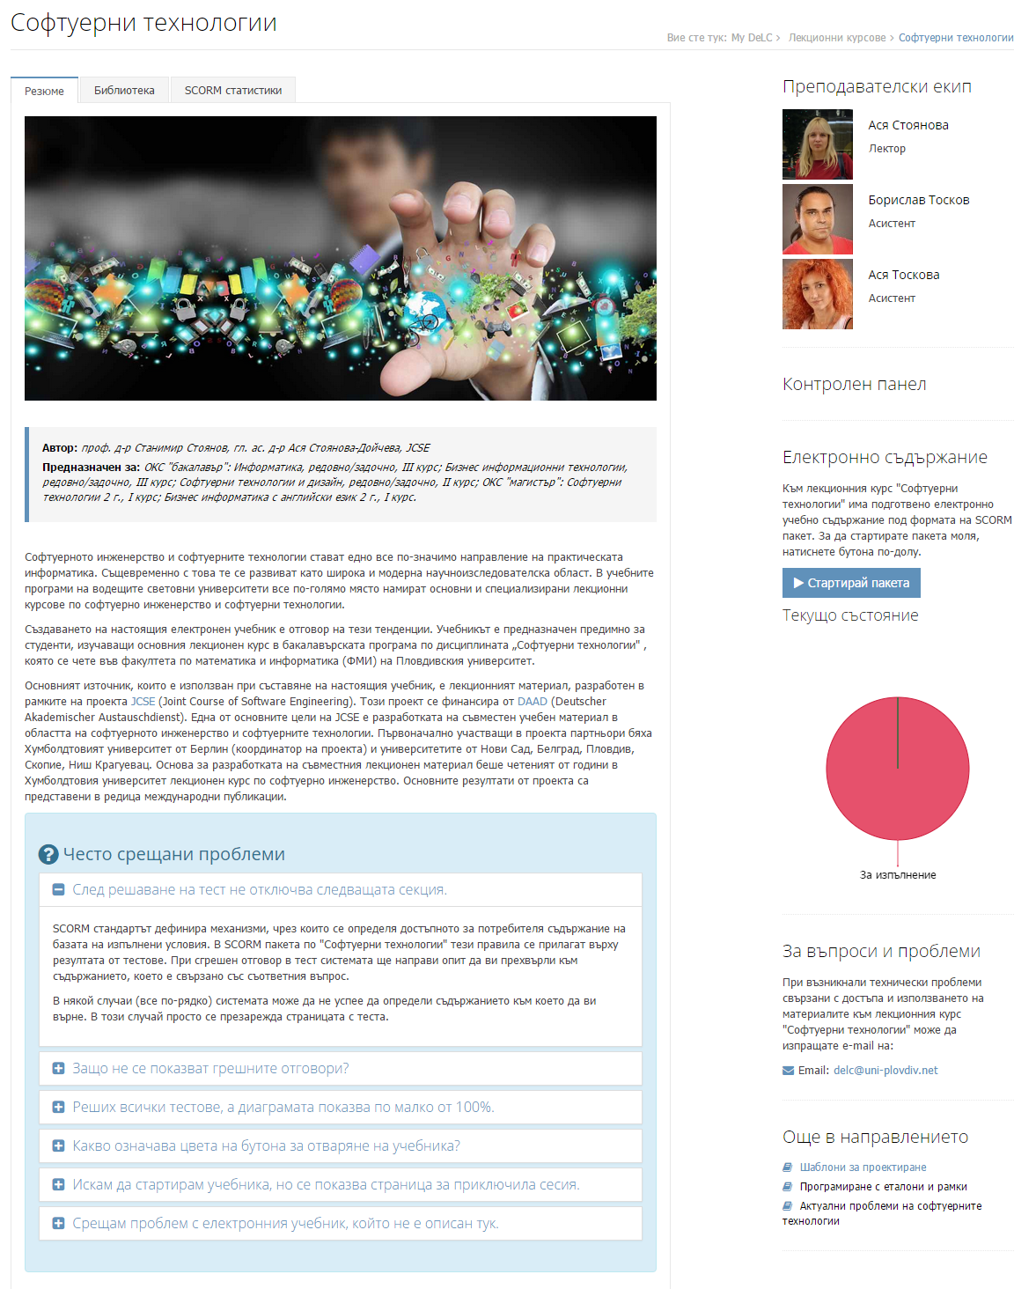
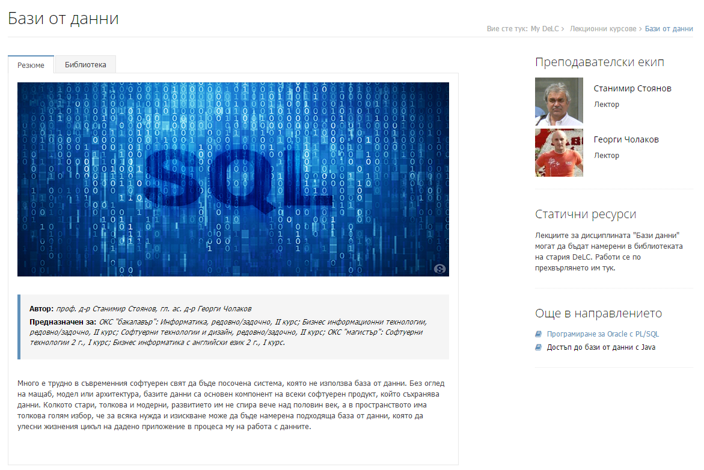
Course Layout

Slide 19
DeLC 2.0 Technologies
Used server side technologies:
  Grails 2.4.4
  Spring Security
  ActiveMQ with JMS
Browser technologies and libraries:
  AJAX requests
  Twitter Bootstrap
  JQuery
  Font Awesome
  ExtJS 5
  Web Sockets

Slide 20
What else?
Control Panel
  User management
  Management of roles and groups
  Rule management
  LDAP automatic synchronization
  Personal messages and notifications broadcast

Slide 21
DeLC 2: In production
To DeLC 2: http://delc2.fmi.uni-plovdiv.net

Slide 22
Last Slide

